Slide 1
Environmental safety in Nuclear energy
Lecture 10

Slide 2
Plan:
1. The concept of Environmental Safety
2. The legal mechanisms of ensuring the environmental safety in the nuclear energy
2.1. environmental permit
2.2. environmental impact assessment (EIA)
2.3. environmental regulation
2.4. technical regulation and standardization
2.5. environmental assessment
2.6.radioactive waste management
2.7.environmental monitoring and control

Slide 3
Environmental safety -
is an acceptable level of negative impact of natural and anthropogenic environmental hazards on the environment and humans.
Environmental safety should be provided in any stages of the life cycle of nuclear energy facilities;
The life cycle of a nuclear energy facility - placement, design, production, construction, commissioning, operation, reconstruction, major repairs, decommissioning, transportation, handling, storage, burial and disposal of nuclear energy facilities;

Slide 4
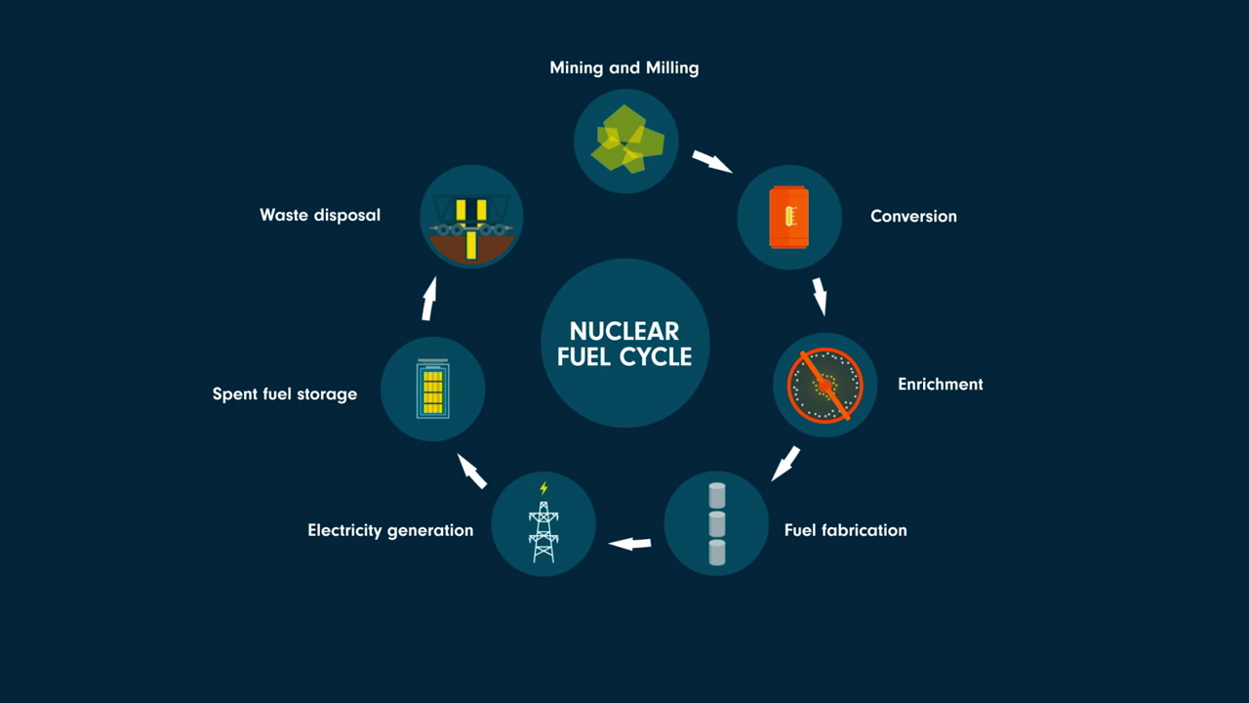

Slide 5
2.1. An environmental permit is a document certifying the right of individual entrepreneurs and legal entities to carry out a negative impact on the environment and defining the environmental conditions for carrying out activities.
Appendix 2 to the Environmental Code of KZ
Types of planned activities and other criteria, on the basis of which objects that have a negative impact are classified on the environment, to objects of I, II or III categories
Section 1. Types of planned activities and other criteria on the basis of which it is carried out classification of objects that have a negative impact on the environment, to objects of category I (most dangerous).
7.12. operation of nuclear installations, including nuclear power plants (with the exception of zero-power research nuclear installations);

Slide 6
Annex 1 to the Environmental Code Republic of Kazakhstan dated January 2, 2021 No. 400-VI ZRK
Section 1. List of types of planned activities and objects for which environmental impact assessment is mandatory
1.6. nuclear power plants and other nuclear reactors, including dismantling or decommissioning of such power plants or reactors
EIA regulated by Environmental Code (articles 65-84)

Slide 7
EIA issues
Types and objects of impacts to be taken into account when assessing environmental impact
Stages of environmental impact assessment
Statement on planned activities
Screening of impacts of planned activities
Criteria for significant environmental impact
Determination of the scope of environmental impact assessment
Report on possible impacts
Public hearings regarding the draft report on possible impacts
Expert commission
Assessment of transboundary impacts carried out during environmental impact assessment
Conclusion on the results of environmental impact assessment
Responsibility for the content of the report on possible impacts
Post-project analysis of actual impacts during the implementation of planned activities
Methodological support for conducting environmental impact assessments

Slide 8
Environmental regulation consists of establishing environmental quality standards, environmental quality targets and standards for permissible anthropogenic impact on the environment.
Environmental quality standards mean a set of quantitative and qualitative characteristics established by the state in relation to the state of individual components of the environment, the achievement and maintenance of which are necessary to ensure a favorable environment.
Based on environmental quality standards, the current state of the environment is assessed and standards for permissible anthropogenic impact on it are established.
Environmental quality standards are developed and established in accordance with Environmental Code separately for each of the following environmental components:
(Emissions to)
atmospheric air;
surface and underground waters;
soils and lands.

Slide 9
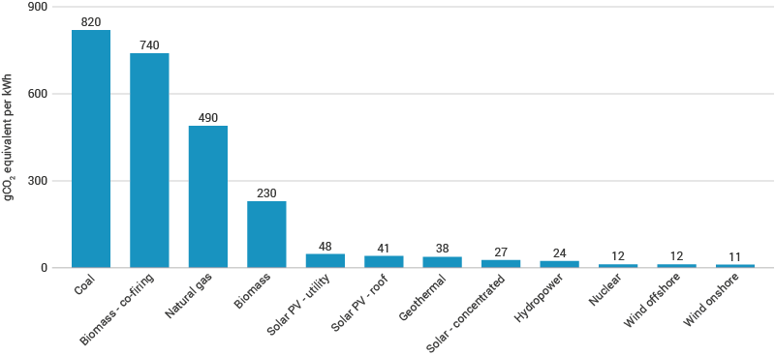

Slide 10
TECHNICAL REGULATION AND STANDARDIZATIONIN THE FIELD OF ENVIRONMENTAL PROTECTION
Law of the Republic of Kazakhstan dated December 30, 2020 No. 396-VI “On technical regulation” - nuclear energy (product)
The introduction and application of international standards in the field of environmental protection are carried out in accordance with the legislation of the Republic of Kazakhstan in the field of standardization, taking into account the requirements of this Code (ISO 14000 – environmental management system)
Law of the Republic of Kazakhstan dated October 5, 2018 No. 183-VI “On standardization”
Eco-labeling
An environmental label is a statement that informs about the environmental aspects of a product in the form of text, a sign or a graphic on the product label or packaging, in accompanying documentation, technical description, advertising brochure, public information leaflet or other form.
Eco-labeling must take into account all aspects of the life cycle of a product, work or service.

Slide 11
Environmental assesment is understood as expert activity aimed at establishing the compliance of documentation (project docs, EIA etc) submitted for environmental assessment with the requirements of the environmental legislation of the Republic of Kazakhstan and carried out in order to prevent possible significant adverse impacts of the implementation of such documentation on public health and the environment, as well as ensuring the environmental foundations of sustainable development of the Republic of Kazakhstan.
EA - state (compulsory) and public (voluntary)
Transparency of the EA and public participation in decision-making on issues of environmental protection and use of natural resources are ensured through public hearings.
Should be published in media

Slide 12
Appendix 4 to the Environmental Code of KZ
Typical list of activities on environmental protection
5) compliance by organizations carrying out activities using atomic energy and with sources of ionizing radiation, requirements for ensuring radiation safety;

